Slide 1




SMART INDIA HACKATHON 2026
TITLE PAGE
  Problem Statement ID –
  Problem Statement Title-
  Theme- Transportation & Logistics
  PS Category- Software
  Team ID- PSV-X17
  Team Name- Nexora
SIH26059
AI-Enabled Antarctic Sea- Ice,Iceberg Trajectory, and Navigation Decision Support System

Slide 2









NEXORA
PROPOSED SOLUTION
AI-Powered Iceberg & Sea-Ice Trajectory Prediction Platform
NOVELTY: AI-powered real-time iceberg trajectory prediction, fused from satellite, buoy, and weather data, for smarter and safer polar navigation.
WHAT
A platform that predicts iceberg and sea-ice drift trajectories in real time by fusing satellite, buoy, and weather data.
WHO
Vessel navigation officers and polar research teams routing ships through ice-prone Antarctic-to-Arctic waters.
WHY
Iceberg data today is scattered across separate satellite, buoy, and weather feeds with no shared reference — officers must manually cross-check sources, delaying decisions and raising collision risk.
HOW
Input: satellite, buoy, and weather data → Process: AI trajectory-prediction engine assigns each berg a persistent Unique ID (size, drift history, hazard class) → Output: role-based dashboards with proximity, routing, and collision-risk alerts.
WHAT'S
NEW
Unlike existing tools that give static, periodic snapshots, Unique Iceberg ID persists across every module and drives predictive — not just observed — real-time trajectories with automated collision alerts.
Satellite / Sensor
Data Sources
→
AI Trajectory
Prediction Engine
→
APIs & Agency /
Research Services
→
Navigation &
Alert Interfaces
2
Notes:
1

Slide 3







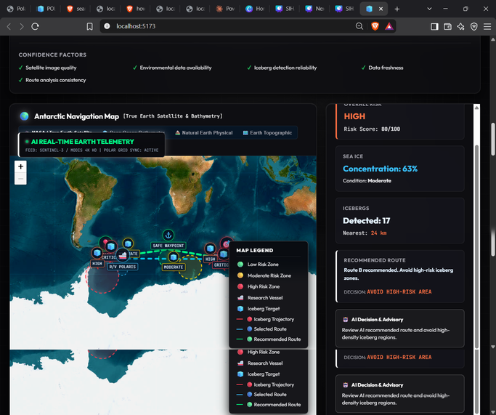
TECHNICAL APPROACH
NEXORA
HIGH-LEVEL ARCHITECTURE / FLOW DIAGRAM
1. INPUT
3. STORE
4. OUTPUT
5. USERS
Environmental Data
AI / ML Pipeline
Data Layer
Decision Support
Role-based Access
  Preprocessing & GIS fusion
  Sea-ice & iceberg analysis
  Trajectory prediction & risk scoring
Add your database / storage choice here
(e.g. spatial + time-series store for drift history, ice concentration, risk scores)
  Vessel navigation officers
  Polar research teams
  Route optimization control
  Satellite imagery
  Ocean & wind data
  Navigation data (APIs / sensors)
  Real-time alerts
  Risk visualization
  Route recommendations
TECH STACK
DATA FLOW
AI / ML
HARDWARE
PROTOTYPE EVIDENCE
Add your frontend, backend,
database, cloud & API stack here
Satellite / ocean / wind APIs →
Preprocessing & GIS fusion →
Prediction models → Dashboard
Sea-ice drift & iceberg
detection / trajectory models,
trained on satellite + ocean data
satellite / ocean feeds
imaginary satellite used
3

Slide 4







FEASIBILITY AND VIABILITY
NEXORA
TECHNICAL
FEASIBILITY
DATA
FEASIBILITY
OPERATIONAL
FEASIBILITY
INFRASTRUCTURE,
SCALABILITY & SECURITY
Sources: Satellite (SAR / optical),
buoy, and weather data
Accessible via open APIs
Supports large-scale ice /
iceberg data, multiple agencies
Proven: Satellite APIs, Python / ML,
PostGIS, Kubernetes
Access: ship dashboards, web,
mobile alerts
RISK REGISTER
DEPLOYMENT PATH
RISK
IMPACT
MITIGATION
Fuse multi-source data (satellite + buoy + weather); cache last-known-good predictions; flag data-confidence to users
Pilot: one high-traffic Antarctic shipping lane (e.g. Drake Passage) with 2–3 partner vessels and one coast-guard / research monitoring station, run for a full season before scaling to additional routes and agencies.
Satellite / sensor data latency or coverage gaps
Delayed or incomplete trajectory predictions, missed hazard alerts
Continuous model validation against historical drift data; human-in-the-loop review for high-risk alerts
False positives / negatives in iceberg detection
Erodes officer trust; ignored real alerts or unnecessary route diversions
Offline-capable on-device alert caching; low-bandwidth satellite-phone / SMS fallback for critical alerts
Limited connectivity in polar / offshore zones
Dashboard and alerts fail to reach vessels in real time
Performance degradation; access-control conflicts across agencies
Role-based access control; horizontally scalable cloud infrastructure; phased agency onboarding
Scaling to multiple agencies / vessels
4

Slide 5





IMPACT AND BENEFITS
NEXORA
TARGET USER &
BENEFICIARY
CURRENT
CONDITION
EXPECTED
CHANGE
BENEFIT CATEGORIES
WHERE THEY APPLY
Around 15,000 icebergs are formed each year, and about 2% of them drift into shipping lanes near the Titanic's sinking location — meaning the hazard volume is large relative to detection capacity
Real-time AI risk analysis &
route recommendations replace
manual, fragmented checking
Magnitude of improvement
Social, Economic, Operational,
Institutional
Environmental — not yet supported
by stated evidence
Primary: Vessel navigation officers
Beneficiary: Coast guard /
maritime research agencies
BENEFITS THAT MATTER
SOCIAL
ECONOMIC
ENVIRONMENTAL
OPERATIONAL
INSTITUTIONAL
Reduces vessel accidents, delays, and loss of life at sea; clearer risk visualization builds trust.
Reduces fuel loss and damage from route diversions and collisions.
Scalable architecture — integrates more satellites, sensors, and AI models over time.
Helps coast guard and research bodies monitor ice hazards efficiently.
No environmental benefit currently stated
5

Slide 6
NEXORA
RESEARCH AND REFERENCES
Evidence used to build and validate the POLAR-SAFE AI navigation system
REFERENCES — SOURCE • CLAIM • USE
WHAT DATA WILL WE USE?
REFERENCE SOURCE | TYPE | CLAIM / USE
ISRO–MOSDAC Antarctic Sea-Ice Data | Government / Satellite | Sea-ice analysis and historical ice patterns
NSIDC Sea Ice Index | Research / Dataset | Sea-ice concentration, extent and trends
ESA Sentinel-1 | Satellite Product | Ice observation and monitoring
Copernicus Marine Service | Operational Dataset | Sea-ice and ocean environmental data
IMO Polar Code | International Standard | Polar navigation and voyage-planning safety
WMO Sea-Ice Guidance | International Standard | Standardized sea-ice information and reporting
  Antarctic sea-ice concentration
  Sea-ice extent and trend data
  Satellite-derived ice observations
  Ocean / environmental observations
  Iceberg position and trajectory information
HOW DO WE VERIFY THE RESULT?
DATA SOURCES → AI ANALYSIS
AI OUTPUT → CROSS-CHECK
CROSS-CHECK → SAFE ROUTE DECISION
6

